Slide 1


SCSA1301-DBMS
SATHYABAMA
INSTITUTE OF SCIENCE AND TECHNOLOGY
UNIT-IV
Dr.L.LAKSHMANAN
DEPARTMENT OF COMPUTER SCIENCE AND ENGINEERING

Slide 2
DATABASE RECOVERY
Purpose of Database Recovery
Types of Failure
Transaction Log
Data Updates
Data Caching
Transaction Roll-back (Undo) and Roll-Forward
Check pointing
Recovery schemes
ARIES Recovery Scheme
Recovery in Multi database System

Slide 3
Purpose of Database Recovery
To bring the database into the last consistent state, which existed prior to the failure.
To preserve transaction properties (Atomicity, Consistency, Isolation and Durability).
Example:
If the system crashes before a fund transfer transaction completes its execution, then either one or both accounts may have incorrect value. Thus, the database must be restored to the state before the transaction modified any of the accounts.

Slide 4
Types of Failure
The database may become unavailable for use due to
Transaction failure: Transactions may fail because of incorrect input, deadlock, incorrect synchronization.
System failure: System may fail because of addressing error, application error, operating system fault, RAM failure, etc.
Media failure: Disk head crash, power disruption, etc.

Slide 5
Transaction Log
For recovery from any type of failure data values prior to modification (BFIM - BeFore Image) and the new value after modification (AFIM – AFter Image) are required.
These values and other information is stored in a sequential file called Transaction log. A sample log is given below.

Slide 6
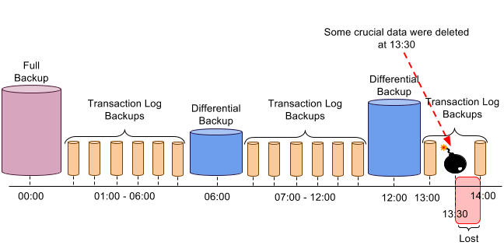

Slide 7
Database Recovery
Data Update
Immediate Update: As soon as a data item is modified in cache, the disk copy is updated.
Deferred Update: All modified data items in the cache is written either after a transaction ends its execution or after a fixed number of transactions have completed their execution.
Shadow update: The modified version of a data item does not overwrite its disk copy but is written at a separate disk location.
In-place update: The disk version of the data item is overwritten by the cache version.

Slide 8
Database Recovery
Data Caching
Data items to be modified are first stored into database cache by the Cache Manager (CM) and after modification they are flushed (written) to the disk.
The flushing is controlled by Modified and Pin-Unpin bits.
Pin-Unpin: Instructs the operating system not to flush the data item.
Modified: Indicates the AFIM of the data item.

Slide 9
Database Recovery
Transaction Roll-back (Undo) and Roll-Forward (Redo)
To maintain atomicity, a transaction’s operations are redone or undone.
Undo: Restore all BFIMs on to disk (Remove all AFIMs).
Redo: Restore all AFIMs on to disk.
Database recovery is achieved either by performing only Undos or only Redos or by a combination of the two. These operations are recorded in the log as they happen.

Slide 10
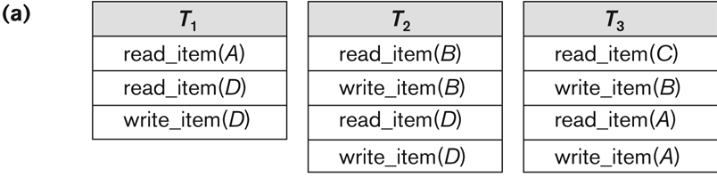
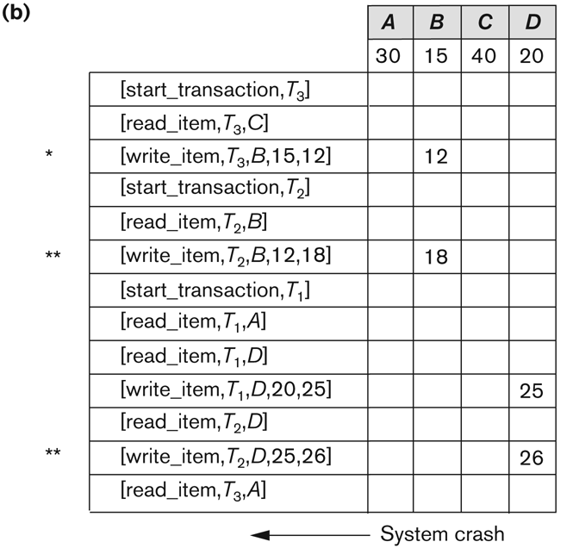
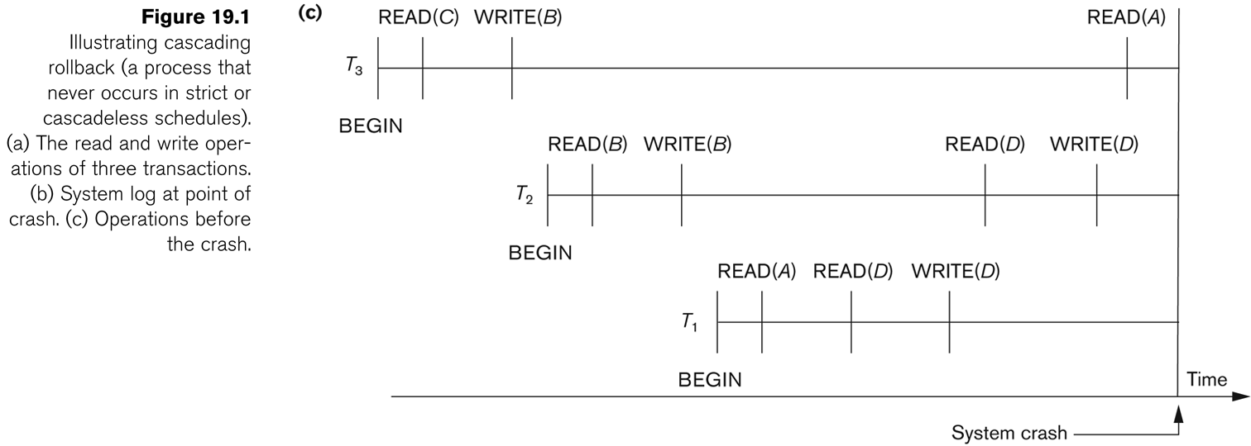

Slide 11
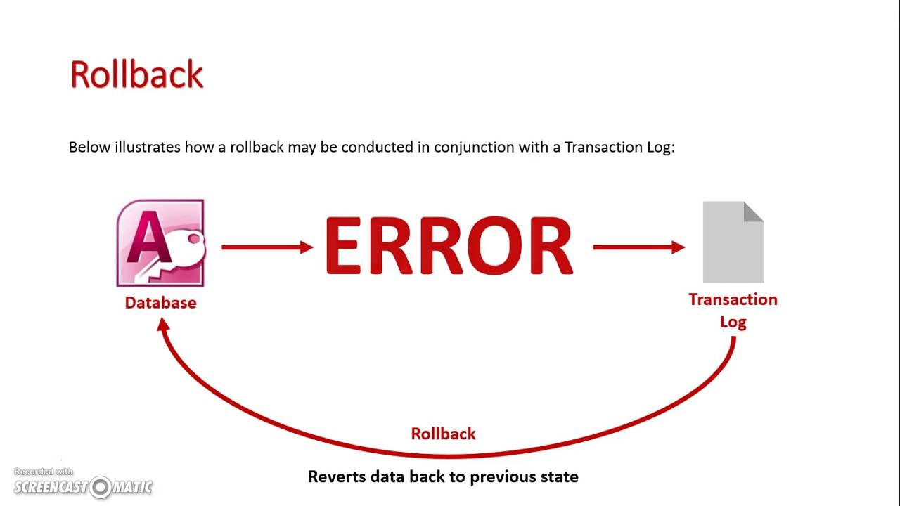
ROLLBACK is a command that causes all data changes since the last BEGIN WORK , or START TRANSACTION to be discarded by the relational database management systems (RDBMS), so that the state of the data is "rolled back" to the way it was before those changes were made.

Slide 12
Database Recovery
Write-Ahead Logging
When in-place update (immediate or deferred) is used then log is necessary for recovery and it must be available to recovery manager. This is achieved by Write-Ahead Logging (WAL) protocol. WAL states that
For Undo: Before a data item’s AFIM is flushed to the database disk (overwriting the BFIM) its BFIM must be written to the log and the log must be saved on a stable store (log disk).
For Redo: Before a transaction executes its commit operation, all its AFIMs must be written to the log and the log must be saved on a stable store.

Slide 13
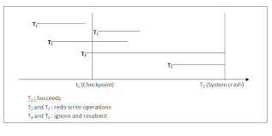
Database Recovery
Check pointing
Time to time (randomly or under some criteria) the database flushes its buffer to database disk to minimize the task of recovery. The following steps defines a checkpoint operation:
Suspend execution of transactions temporarily.
Force write modified buffer data to disk.
Write a [checkpoint] record to the log, save the log to disk.
Resume normal transaction execution.
During recovery redo or undo is required to transactions appearing after [checkpoint] record.

Slide 14
Database Recovery
Steal/No-Steal and Force/No-Force
Possible ways for flushing database cache to database disk:
Steal: Cache can be flushed before transaction commits.
No-Steal: Cache cannot be flushed before transaction commit.
Force: Cache is immediately flushed (forced) to disk.
No-Force: Cache is deferred until transaction commits
These give rise to four different ways for handling recovery:
Steal/No-Force (Undo/Redo)
Steal/Force (Undo/No-redo)
No-Steal/No-Force (Redo/No-undo)
No-Steal/Force (No-undo/No-redo)

Slide 15
Database Recovery-Recovery Scheme
Deferred Update (No Undo/Redo)
Immediate Update(Undo/No Redo)

Slide 16
Database Recovery-Recovery Scheme
Deferred Update (No Undo/Redo)
The data update goes as follows:
A set of transactions records their updates in the log.
At commit point under WAL scheme these updates are saved on database disk.
After reboot from a failure the log is used to redo all the transactions affected by this failure. No undo is required because no AFIM is flushed to the disk before a transaction commits.

Slide 17
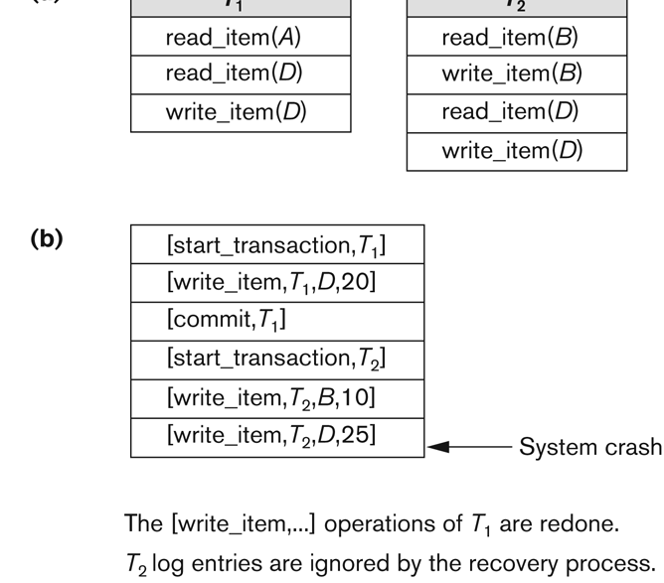
Deferred Update in a single-user system There is no concurrent data sharing in a single user system. The data update goes as follows:
A set of transactions records their updates in the log.
At commit point under WAL scheme these updates are saved on database disk.
After reboot from a failure the log is used to redo all the transactions affected by this failure. No undo is required because no AFIM is flushed to the disk before a transaction commits.

Slide 18
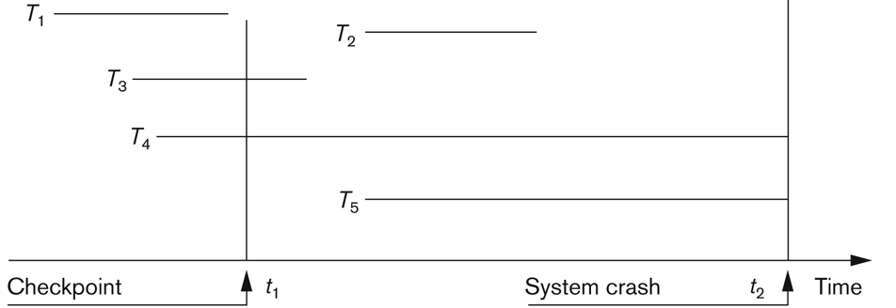
Deferred Update with concurrent users
This environment requires some concurrency control mechanism to guarantee isolation property of transactions. In a system recovery transactions which were recorded in the log after the last checkpoint were redone. The recovery manager may scan some of the transactions recorded before the checkpoint to get the AFIMs.

Slide 19
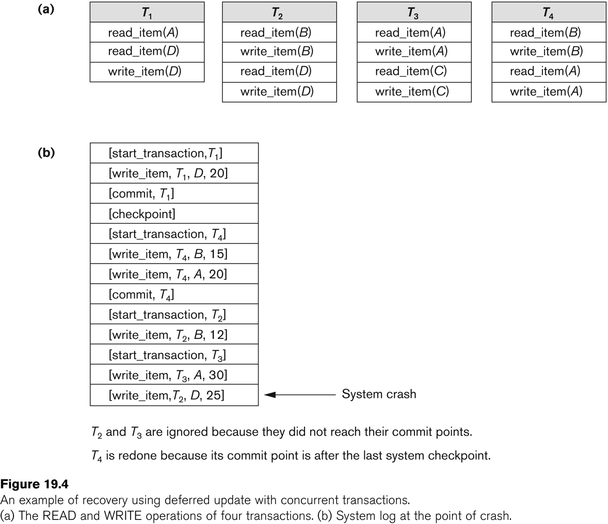
Deferred Update with concurrent users
Two tables are required for implementing this protocol:
Active table: All active transactions are entered in this table.
Commit table: Transactions to be committed are entered in this table.

Slide 20
During recovery, all transactions of the commit table are redone and all transactions of active tables are ignored since none of their AFIMs reached the database. It is possible that a commit table transaction may be redone twice but this does not create any inconsistency because of a redone is “idempotent”, that is, one redone for an AFIM is equivalent to multiple redone for the same AFIM.

Slide 21
Database Recovery
Recovery Techniques Based on Immediate Update
Undo/No-redo Algorithm
In this algorithm AFIMs of a transaction are flushed to the database disk under WAL before it commits.
For this reason the recovery manager undoes all transactions during recovery.
No transaction is redone.
It is possible that a transaction might have completed execution and ready to commit but this transaction is also undone.

Slide 22
Database Recovery
Recovery Techniques Based on Immediate Update
Undo/Redo Algorithm (Single-user environment)
Recovery schemes of this category apply undo and also redo for recovery.
In a single-user environment no concurrency control is required but a log is maintained under WAL.
Note that at any time there will be one transaction in the system and it will be either in the commit table or in the active table.
The recovery manager performs:
Undo of a transaction if it is in the active table.
Redo of a transaction if it is in the commit table.

Slide 23
Database Recovery
Recovery Techniques Based on Immediate Update
Undo/Redo Algorithm (Concurrent execution)
Recovery schemes of this category applies undo and also redo to recover the database from failure.
In concurrent execution environment a concurrency control is required and log is maintained under WAL.
Commit table records transactions to be committed and active table records active transactions. To minimize the work of the recovery manager checkpointing is used.
The recovery performs:
Undo of a transaction if it is in the active table.
Redo of a transaction if it is in the commit table.

Slide 24
Database Recovery
Shadow Paging
The AFIM does not overwrite its BFIM but recorded at another place on the disk. Thus, at any time a data item has AFIM and BFIM (Shadow copy of the data item) at two different places on the disk.
X and Y: Shadow copies of data items
X' and Y': Current copies of data items

Slide 25
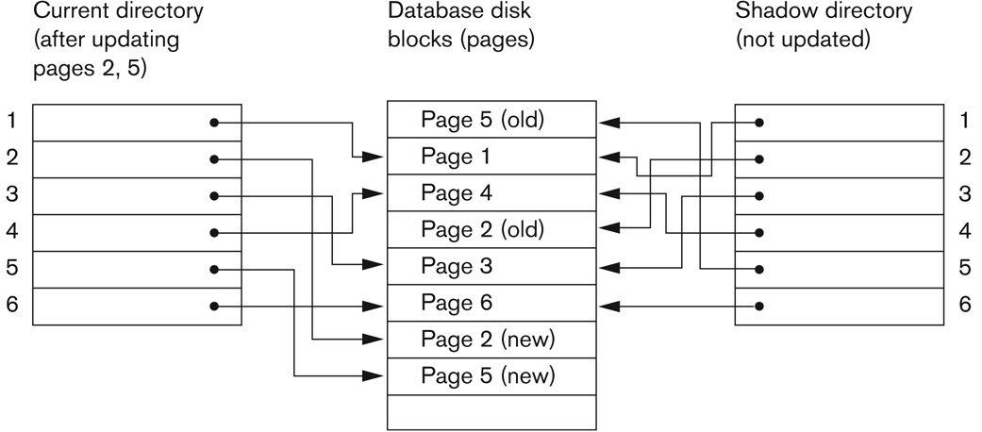
Database Recovery
Shadow Paging
To manage access of data items by concurrent transactions two directories (current and shadow) are used.
The directory arrangement is illustrated below. Here a page is a data item.

Slide 26
Database Recovery
The ARIES Recovery Algorithm
The ARIES Recovery Algorithm is based on:
WAL (Write Ahead Logging)
Repeating history during redo:
ARIES will retrace all actions of the database system prior to the crash to reconstruct the database state when the crash occurred.
Logging changes during undo:
It will prevent ARIES from repeating the completed undo operations if a failure occurs during recovery, which causes a restart of the recovery process.

Slide 27
Database Recovery
The ARIES Recovery Algorithm (contd.)
The ARIES recovery algorithm consists of three steps:
Analysis: step identifies the dirty (updated) pages in the buffer and the set of transactions active at the time of crash. The appropriate point in the log where redo is to start is also determined.
Redo: necessary redo operations are applied.
Undo: log is scanned backwards and the operations of transactions active at the time of crash are undone in reverse order.

Slide 28
Database Recovery
The ARIES Recovery Algorithm (contd.)
The Log and Log Sequence Number (LSN)
A log record is written for:
(a) data update
(b) transaction commit
(c) transaction abort
(d) undo
(e) transaction end
In the case of undo a compensating log record is written.

Slide 29
Database Recovery
The ARIES Recovery Algorithm (contd.)
The Transaction table and the Dirty Page table
For efficient recovery following tables are also stored in the log during check pointing:
Transaction table: Contains an entry for each active transaction, with information such as transaction ID, transaction status and the LSN of the most recent log record for the transaction.
Dirty Page table: Contains an entry for each dirty page in the buffer, which includes the page ID and the LSN corresponding to the earliest update to that page.

Slide 30
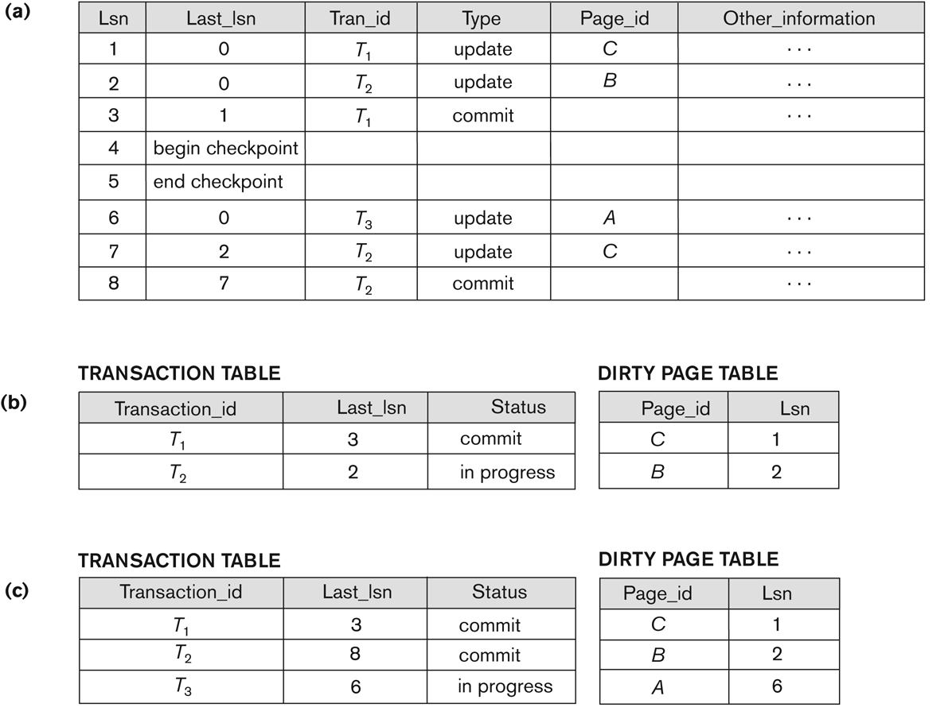
Database Recovery

Slide 31
Database Recovery
Recovery in multidatabase system
A Multidatabase system is a special distributed database system where one node may be running relational database system under UNIX, another may be running object-oriented system under Windows and so on.
A transaction may run in a distributed fashion at multiple nodes.
In this execution scenario the transaction commits only when all these multiple nodes agree to commit individually the part of the transaction they were executing.
This commit scheme is referred to as “two-phase commit” (2PC).
If any one of these nodes fails or cannot commit the part of the transaction, then the transaction is aborted.
Each node recovers the transaction under its own recovery protocol.

Slide 32
What is Database Security ?
DataBase:
It is a collection of data ,generally stored and accessed
electronically from a computer system.
Security
It is being free from danger.
Database Security
It is the mechanisms that protect the database against
intentional or accidental threats.

Slide 33
Major Security Vulnerabilities
Bugs in database software components(eg-buffer overflow)
Improper security configurations
Use of default user accounts and passwords
Use of null passwords
Excessive privileges
Lack of network isolation(external or internal)

Slide 34
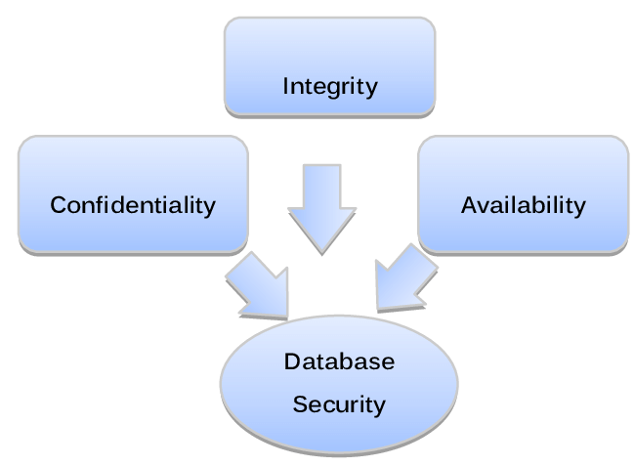

Slide 35
Database Security Issues
Types of Security
Legal and ethical issues
Policy issues
System-related issues
The need to identify multiple security levels

Slide 36
Database Security Issues
A DBMS typically includes a database security and authorization subsystem that is responsible for ensuring the security portions of a database against unauthorized access.
Two types of database security mechanisms:
Discretionary security mechanisms
Mandatory security mechanisms

Slide 37
Database Security Issues
The security mechanism of a DBMS must include provisions for restricting access to the database as a whole; this function is called access control and is handled by creating user accounts and passwords to control login process by the DBMS.
The security problem associated with databases is that of controlling the access to a statistical database, which is used to provide statistical information or summaries of values based on various criteria.
The countermeasures to statistical database security problem is called inference control measures.

Slide 38
Database Security Issues
Another security is that of flow control, which prevents information from flowing in such a way that it reaches unauthorized users.
Channels that are pathways for information to flow implicitly in ways that violate the security policy of an organization are called covert channels.
A final security issue is data encryption, which is used to protect sensitive data (such as credit card numbers) that is being transmitted via some type communication network.

Slide 39
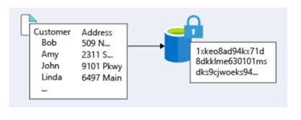
Database Security Issues
The data is encoded using some coding algorithm. An unauthorized user who access encoded data will have difficulty deciphering it, but authorized users are given decoding or decrypting algorithms (or keys) to decipher data.

Slide 40
Database Security and the DBA
The database administrator (DBA)
The DBA has a DBA account in the DBMS, sometimes called a System or Super user account, which provides powerful capabilities

Slide 41
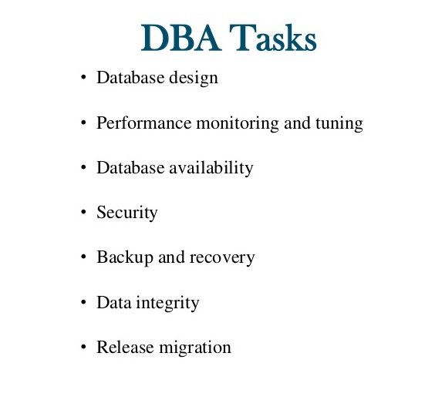
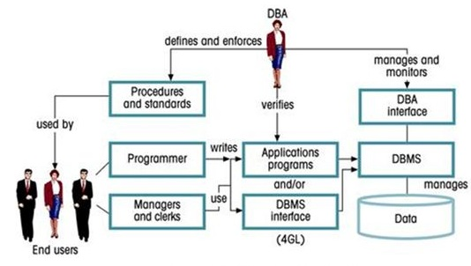

Slide 42
Database Security and the DBA
1. Account creation
2. Privilege granting
3. Privilege revocation
4. Security level assignment
Action 1 is access control,
2 and 3 are discretionary and
4 is used to control mandatory authorization.

Slide 43
Access Protection, User Accounts, and Database Audits
Whenever a person or group of persons need to access a database system, the individual or group must first apply for a user account.
The DBA will then create a new account number and password for the user if there is a legitimate need to access the database.
The user must log in to the DBMS by entering account number and password whenever database access is needed.

Slide 44
Types of Discretionary Privileges
The account level: At this level, the DBA specifies the particular privileges that each account holds independently of the relations in the database.
The relation (or table level): At this level, the DBA can control the privilege to access each individual relation or view in the database.
The privileges at the account level
CREATE SCHEMA or CREATE TABLE
CREATE VIEW privilege;
ALTER privilege,
DROP privilege,
SELECT privilege

Slide 45
Key Difference
grant vs revoke
grant is a DCL command that allows providing privileges for the users on the database objects. | revoke is a DCL command that allows taking back the permission assigned to a user.
In Decentralized Control
The grant is easier. | The revoke is complex.
Usage
Allows assigning access rights to the users. | Allows removing the access rights from the users.

Slide 46
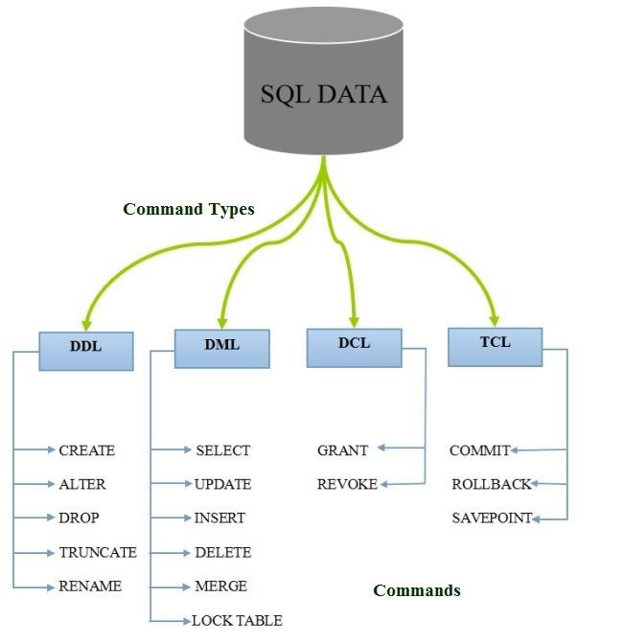

Slide 47
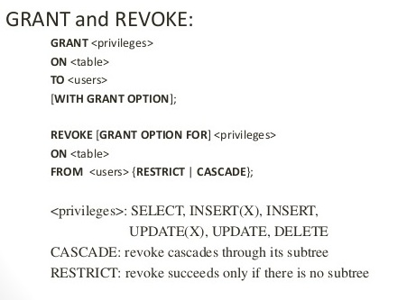
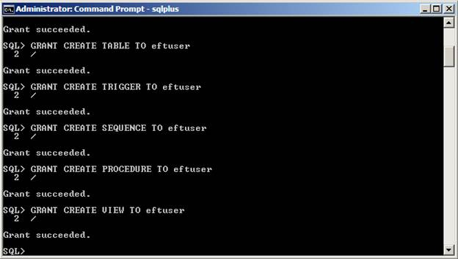

Slide 48
Mandatory Access Control
In many applications, and additional security policy is needed that classifies data and users based on security classes.
Mandatory policies ensure a high degree of protection in a way, they prevent any illegal flow of information

Slide 49
Typical security classes
Top secret (TS),
Secret (S),
Confidential (C),
unclassified (U),
TS is the highest level and U the lowest
The commonly used model for multilevel security, known as the Bell-LaPadula model.

Slide 50
Security Classifications
subject (user, account, program)
object (relation, tuple, column, view, operation)
Two restrictions are enforced on data access based on the subject/object classifications:
simple security property-A subject S is not allowed read access to an object O unless class(S) ≥ class(O).
star property -A subject S is not allowed to write an object O unless class(S) ≤ class(O).

Slide 51
Role-Based Access Control
RBAC-managing and enforcing security in large-scale enterprise wide systems
Roles can be created using the CREATE ROLE and DESTROY ROLE
CREATE ROLE role_name [WITH ADMIN {CURRENT_USER
| CURRENT_ROLE}]
Role hierarchy in RBAC is a natural way of organizing roles to reflect the organization’s lines of authority and responsibility.
Many DBMSs have allowed the concept of roles, where privileges can be assigned to roles.

Slide 52
Debate on
Distributed Database and Client Server Architecture

Slide 53
Distributed Database Concepts
What constitutes a distributed database?
Connection of database nodes over computer network
Logical interrelation of the connected databases
Possible absence of homogeneity among connected nodes
Distributed database management system (DDBMS)
Software system that manages a distributed database

Slide 54
Distributed Database Concepts (cont’d.)
Local area network
Hubs or cables connect sites
Long-haul or wide area network
Telephone lines, cables, wireless, or satellite connections
Network topology defines communication path
Transparency
Hiding implementation details from the end user

Slide 55
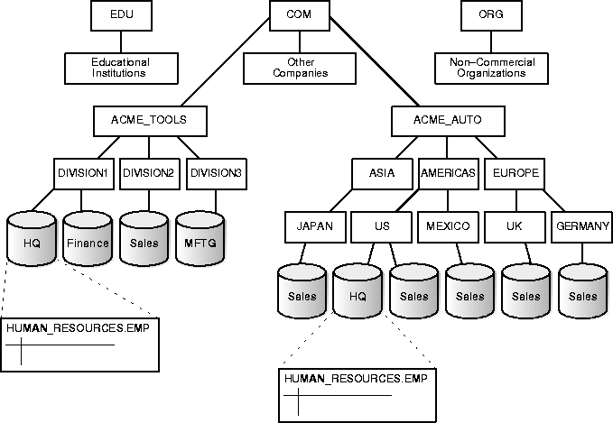
Distributed Database Example

Slide 56
Characteristics of DDB
Types of transparency
Data organization transparency
Location transparency
Naming transparency
Replication transparency
Fragmentation transparency
Horizontal fragmentation
Vertical fragmentation
Design transparency
Execution transparency

Slide 57
Characteristics of DDB
Availability
Probability that the system is continuously available during a time interval
Reliability
Probability that the system is running (not down) at a certain time point
Both directly related to faults, errors, and failures
Fault-tolerant approaches

Slide 58
Scalability and Partition Tolerance
Horizontal scalability
Expanding the number of nodes in a distributed system
Vertical scalability
Expanding capacity of the individual nodes
Partition tolerance
System should have the capacity to continue operating while the network is partitioned

Slide 59
Autonomy
Determines extent to which individual nodes can operate independently
Design autonomy
Independence of data model usage and transaction management techniques among nodes
Communication autonomy
Determines the extent to which each node can decide on sharing information with other nodes
Execution autonomy
Independence of users to act as they please

Slide 60
Advantages of Distributed Databases
Improved ease and flexibility of application development
Development at geographically dispersed sites
Increased availability
Isolate faults to their site of origin
Improved performance
Data localization
Easier expansion via scalability
Easier than in non-distributed systems

Slide 61
Data Fragmentation in Distributed Database Design
Fragments
Logical units of the database
Horizontal fragmentation (sharding)
Horizontal fragment or shard of a relation is a subset of the tuples in that relation
Can be specified by condition on one or more attributes or by some other method
Groups rows to create subsets of tuples
Each subset has a certain logical meaning

Slide 62
Data Fragmentation (cont’d.)
Vertical fragmentation
Divides a relation vertically by columns
Keeps only certain attributes of the relation
Complete horizontal fragmentation
Apply UNION operation to the fragments to reconstruct relation
Complete vertical fragmentation
Apply OUTER UNION or FULL OUTER JOIN operation to reconstruct relation

Slide 63
Data Replication and Allocation
Fully replicated distributed database
Replication of whole database at every site in distributed system
Improves availability remarkably
Update operations can be slow
Partial replication
Some fragments are replicated and others are not
Defined by replication schema
Data allocation (data distribution)
Each fragment assigned to a particular site in the distributed system
Choices depend on performance and availability goals of the system

Slide 64
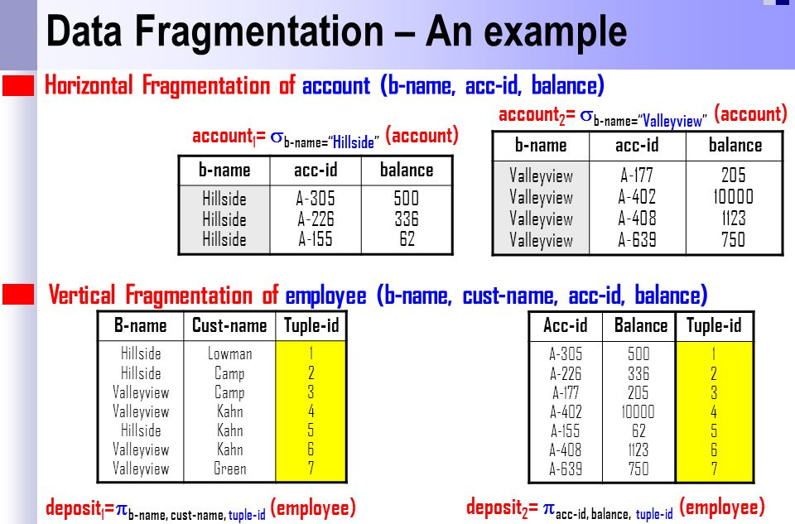

Slide 65
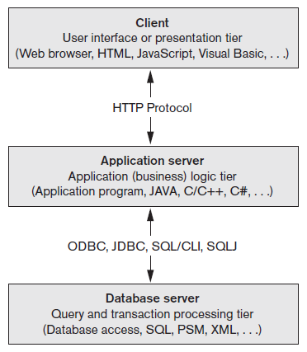
An Overview of Three-Tier Client/Server Architecture
Division of DBMS functionality among the three tiers can vary

Slide 66
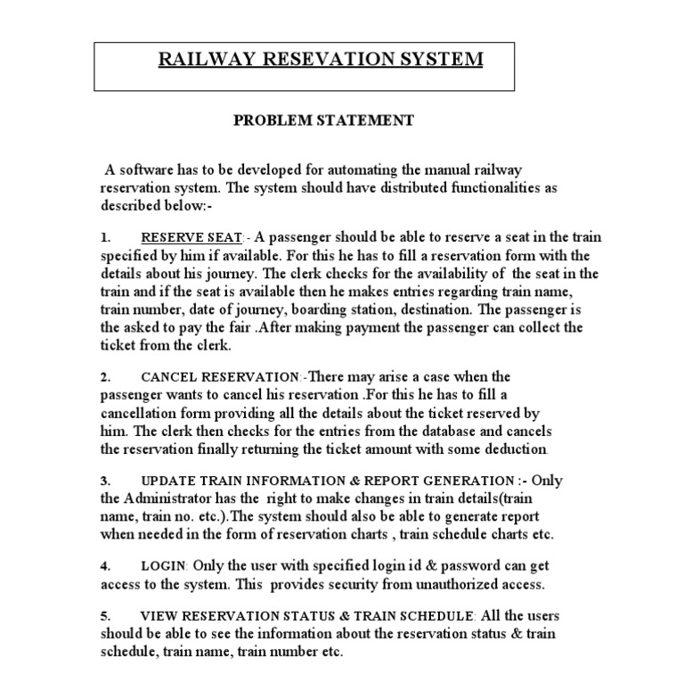
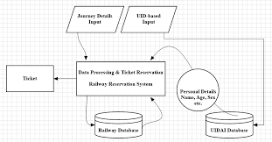
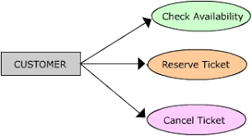
An Overview of Railway Reservation System

Slide 67
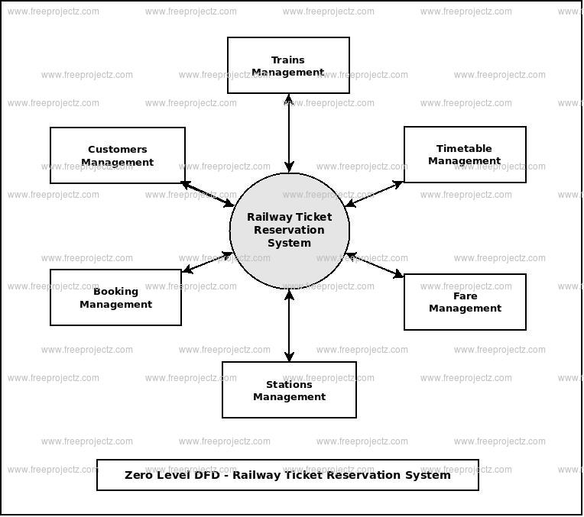
DFD - Railway Reservation System

Slide 68
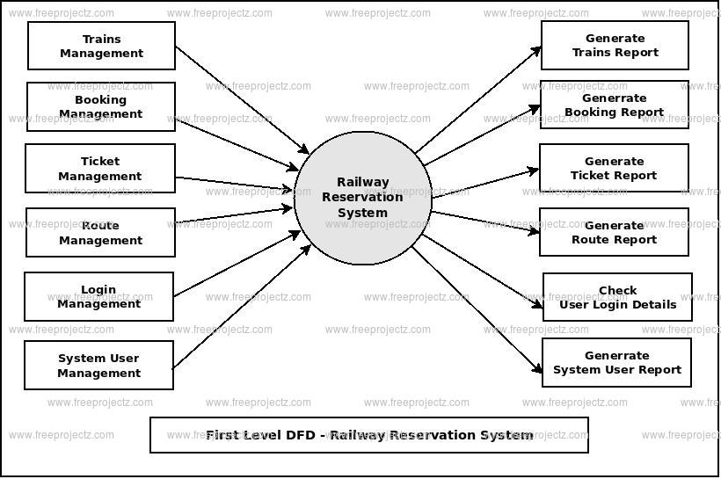

Slide 69
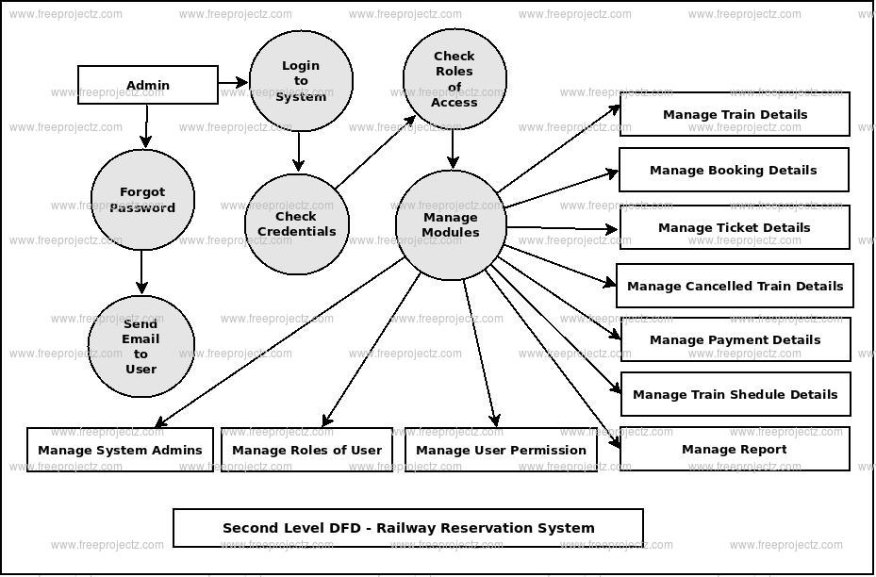

Slide 70
THANK YOU
ANY QUERIES ?
Dr.L.LAKSHAMAN
Lakshmanan.cse@sathyabama.ac.in

